Slide 1

Solve - 2 - Silence
Presented by :
T.Keerthana
Batch No : 504

Slide 2
About Me
Background:
I completed my Bachelor of Technology in CSE from Bhoj Reddy Engineering College for Women.
Why you want to learn Data Science:
I want to learn data science to improve my skills and get high payeable job.
Any work experience:
So, far I have no experience
LinkedIn : www.linkedin.com/in/keerthana-thurpati
GitHub : https://github.com/KeerthanaThurpati

Slide 3
Agenda
Introduction
Objective of the Project
Problem Statement
Concepts Used
Working of the System
Execution of Code
Conclusion
Q&A

Slide 4
Business Problem
Many individuals, including students and working professionals, struggle with waking up on time due to ineffective traditional alarm systems.Conventional alarms can be easily snoozed or turned off, leading to oversleeping and reduced productivity.Oversleeping results in missed deadlines, late attendance, and decreased efficiency in academic and professional environments.Therefore, a solution is required that enforces user interaction and cognitive engagement to ensure proper wakefulness and improve productivity.

Slide 5
Introduction
Solve 2 Silence is an innovative and interactive alarm system designed to improve user alertness and prevent oversleeping. Traditional alarm systems often fail to ensure wakefulness, as users can easily snooze or dismiss them without becoming fully active.
This project addresses that limitation by introducing a cognitive challenge that must be solved to deactivate the alarm.
Overall, Solve 2 Silence enhances productivity and encourages disciplined daily routines through an intelligent and interactive approach.

Slide 6
Objective
The primary objective of Solve 2 Silence is to develop an intelligent and interactive alarm system that enhances user alertness by requiring a problem-solving task to deactivate the alarm.
Additionally, the project aims to demonstrate the practical implementation of core programming concepts such as time-based operations, control structures, exception handling, and random number generation in a real-time environment.
The system is designed to promote discipline, improve productivity, and provide a simple yet effective solution to everyday time management challenges.

Slide 7
Problem Statement
In today’s fast-paced lifestyle, many individuals struggle to wake up on time due to the inefficiency of traditional alarm systems. Conventional alarms can be easily snoozed or turned off without requiring any active engagement, which often leads to oversleeping, reduced productivity, and poor time management.
Therefore, the problem addressed in this project is to design and develop a smart alarm system that prevents passive dismissal by requiring the user to actively engage in a simple problem-solving task, ensuring mental alertness and promoting a disciplined daily routine.

Slide 8
Concepts Used
Modules Used:time,random,winsound
time module:Uses the time module to fetch and monitor the current system time.Compares current time with the user-defined alarm time.
random module:Uses the random module to generate dynamic math problems.
winsound module:Uses winsound (Windows) or playsound to play alarm audio.Implements looping sound until the correct answer is provided.
2. Loops (while): For continuous time checking and repeated user input.
3. Conditional Statments (if-else):To trigger the alarm and validate answers.

Slide 9
Concepts Used (contd.)
Exception Handling:Implements try-except to handle invalid inputs (e.g., non-numeric values).Prevents program crashes and improves user experience.
User Input Handling:Uses input() function to accept alarm time and answers from the user.Converts input into appropriate data types.

Slide 10
Working of the Program
The user enters the alarm time in HH:MM format (24-hour format).
The program stores the entered time and starts execution.
It continuously checks the current system time using the time module.
The current time is compared with the user-set alarm time at regular intervals.
When both times match, the alarm is triggered.

Slide 11
Working of the Program(contd.)
A sound is played continuously in the background using the winsound module.
Two random numbers are generated to create a simple math problem using random module.
The user is prompted to solve the problem to stop the alarm.
The program accepts user input and checks whether it is valid or not.

Slide 12
Working of the Program(contd.)
If the entered answer is incorrect, the alarm continues to ring and the user is asked again until the user enters correct answer.
If the answer is correct, the alarm sound stops immediately.
A confirmation message is displayed indicating the alarm has been stopped.
The program then terminates successfully.

Slide 13
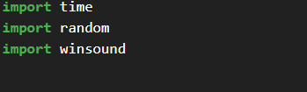

Importing time,sound,random modules.
Taking input(alarm time) from user which will be stored in alarm_time

Slide 14
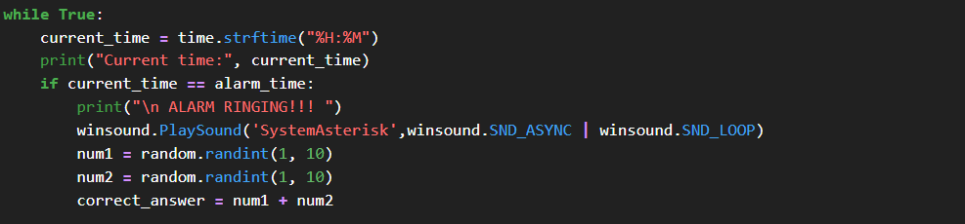
It checks the current time if current matches with alarm time then alarm will ring a sound using winsound module.
num1 and num2 are numbers which generated by computer sum of those 2 numbers is stored in correct answer.

Slide 15
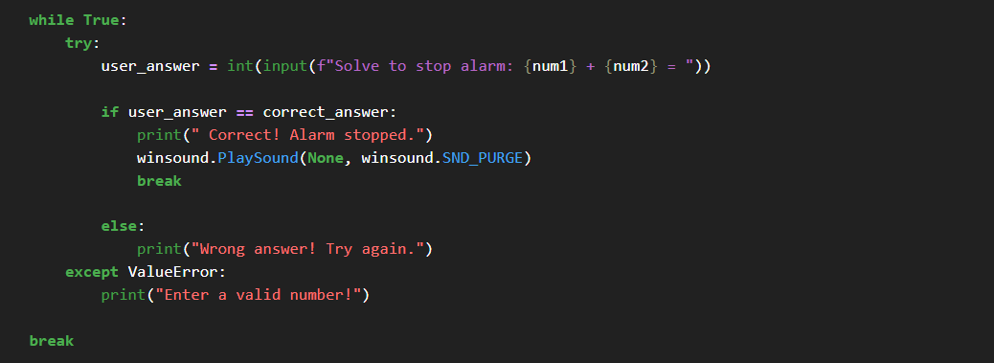
If the user entered answer matches with correct answer then it display Correct! Alarm stopped message else wrong answer Try again.The alarm sound will ring until you enter correct answer.

Slide 16
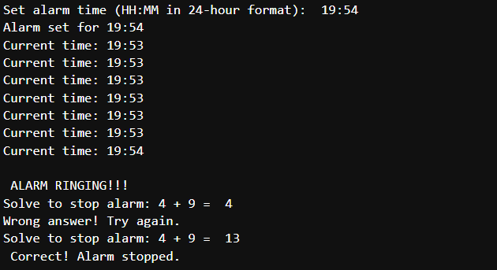
Execution Of The Code
Enter input in 24 hour format time

Slide 17
Conclusion
The Solve 2 Silence project successfully demonstrates the development of an intelligent and interactive alarm system that enhances user alertness through active engagement. By integrating a problem-solving mechanism, the system effectively prevents users from passively dismissing the alarm, thereby reducing the chances of oversleeping.

Slide 18


Slide 19


